Slide 1
Fitness Buddy
IBM HACKATHON PROJECT
Presented By:
Student name : Nitin Chahar
College Name : Ch. Ranbir Singh State Institute of Engineering and Technology
Department : Computer Science & Engineering

Slide 2
OUTLINE
Problem Statement
Technology used
IBM Cloud services used
Wow factor
End users
Result
Conclusion
Git-hub Link
Future scope
IBM Certifications

Slide 3
Problem Statement
Purpose:
Define the challenge that led to the project.
Content:
People lack personalized fitness guidance.
Maintaining consistent workout schedules and diet plans is difficult.
Most apps lack interactive AI-based solutions.

Slide 4
Technology used
IBM Cloud (Hosting)
IBM Watson Assistant (Chatbot AI)
IBM Granite LLM (Contextual Answer Generation)
Node.js, Express.js (Backend)
HTML, CSS, JavaScript (Frontend)
Cloud Foundry (Deployment)

Slide 5
IBM cloud services used
Purpose: Show IBM’s role in the solution.
Content:
Watson Assistant for natural language processing
Cloud Foundry for application deployment
IBM Cloud Functions for serverless execution
IBM Object Storage for user data
IBM granite LLM for retrieve information

Slide 6
Wow factors
Purpose: Highlight what makes our project unique.
What to Include:
24/7 Virtual Assistant
Personalized plans
Voice-based interaction
IBM Cloud scalability
Why It Matters: Differentiates your solution from ordinary apps.

Slide 7
End users
Purpose: Show practical applicability.
What to Include:
Fitness Enthusiasts
Gym Trainers
Wellness Centers
Corporate Health Programs
Why It Matters: Proves real-world relevance and target market.

Slide 8
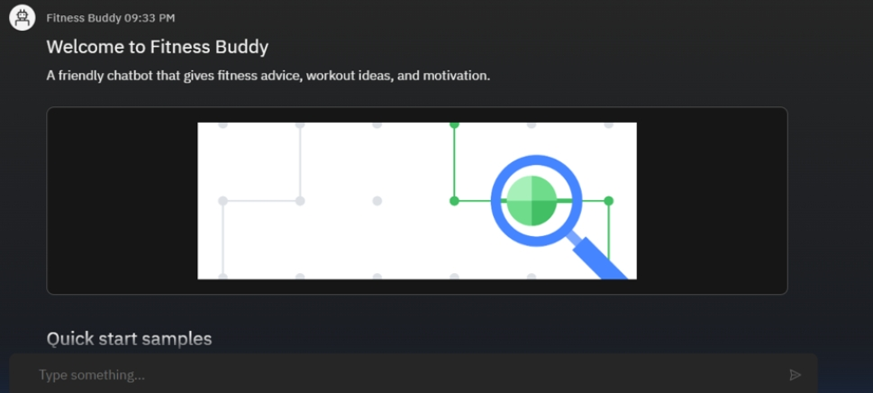
Results

Slide 9
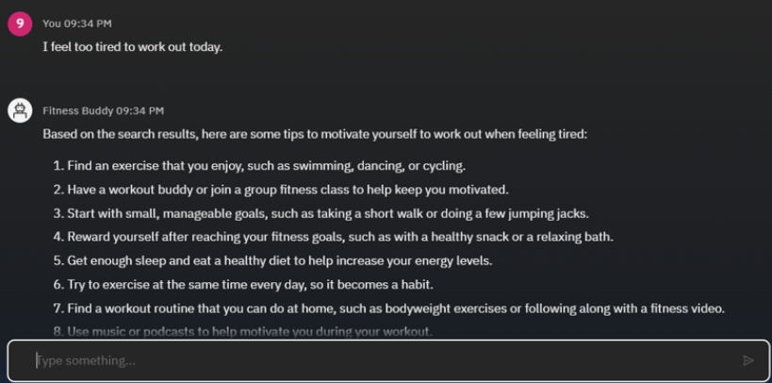
Results

Slide 10
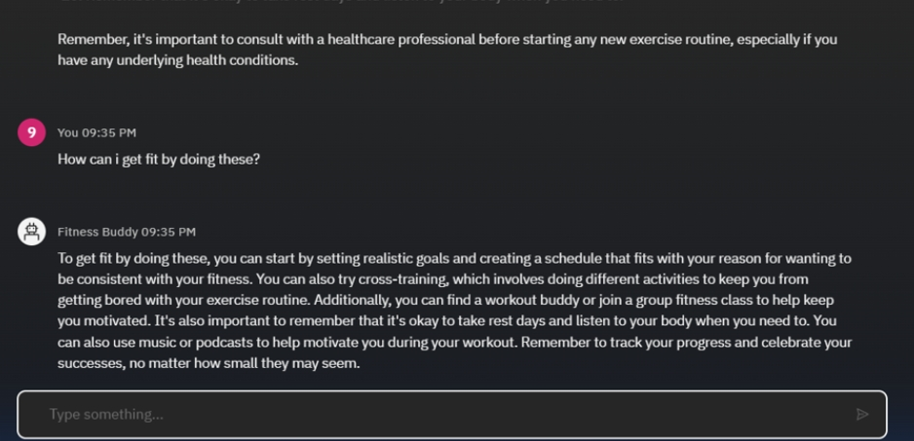
Results

Slide 11
Conclusion
The project successfully integrates AI-powered fitness assistance with IBM Cloud for scalability and reliability.
Provides personalized workout and diet plans, making fitness guidance accessible anytime, anywhere.
Demonstrates the power of IBM Watson Assistant and Cloud services in building real-world solutions.

Slide 12
GitHub Link
https://github.com/nitin-create10/fitness-agent-.git

Slide 13
Future scope
Purpose: Show growth potential.
What to Include:
Integration with wearables
AI-based progress tracking
Multi-language support
Video-based training sessions
Why It Matters: Investors and evaluators look for scalability and vision.

Slide 14
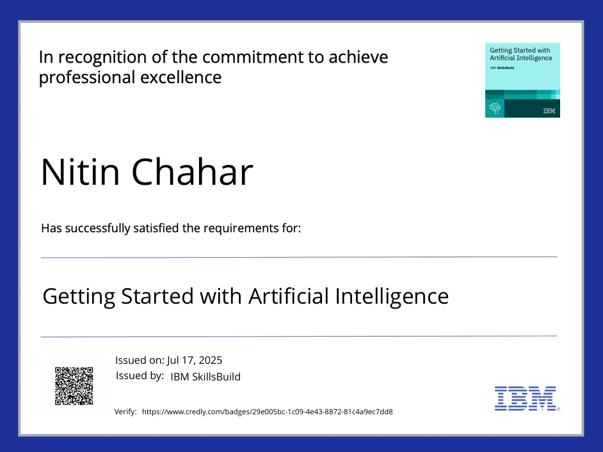
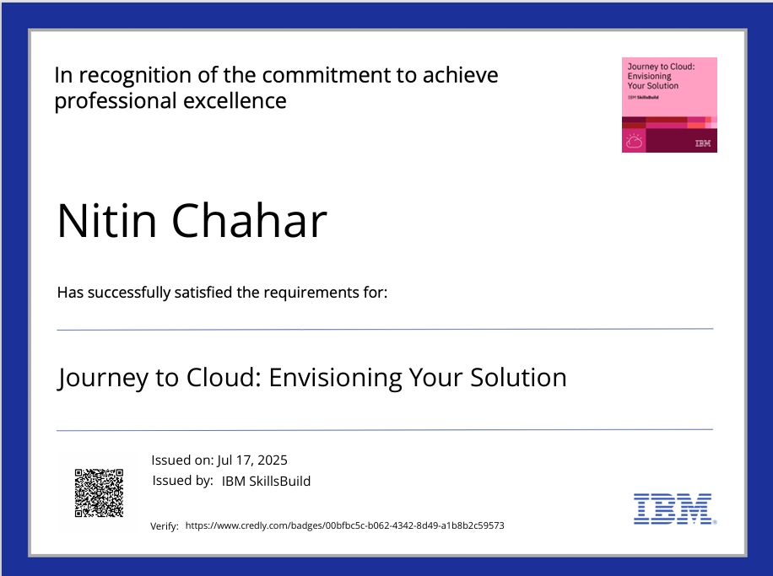
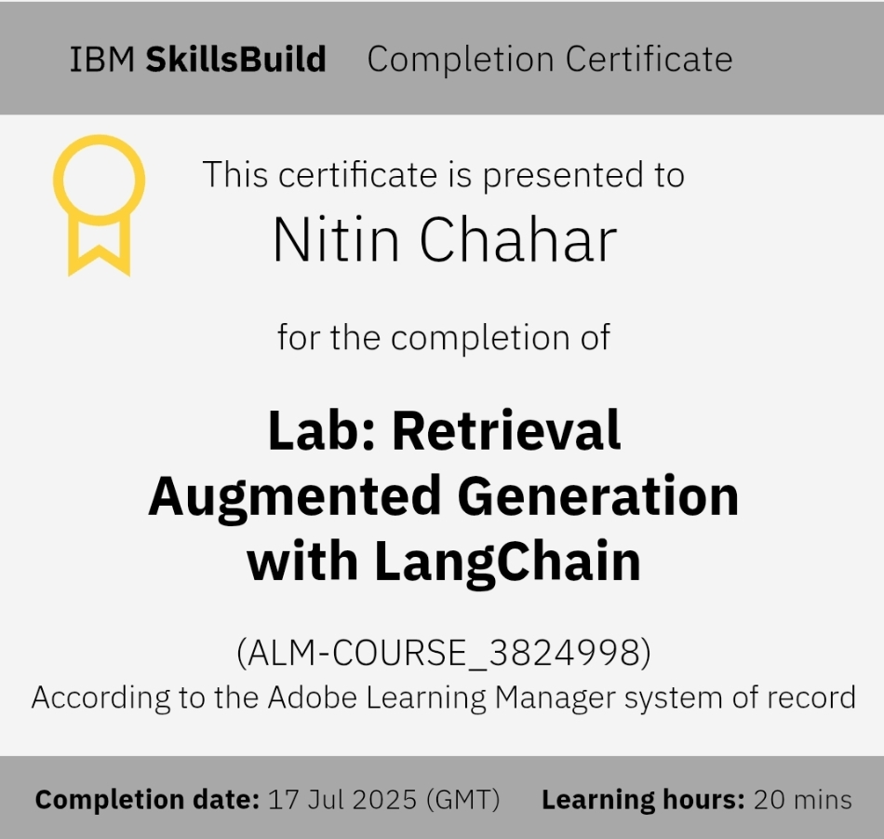
IBM Certifications

Slide 15
THANK YOU

